Slide 1
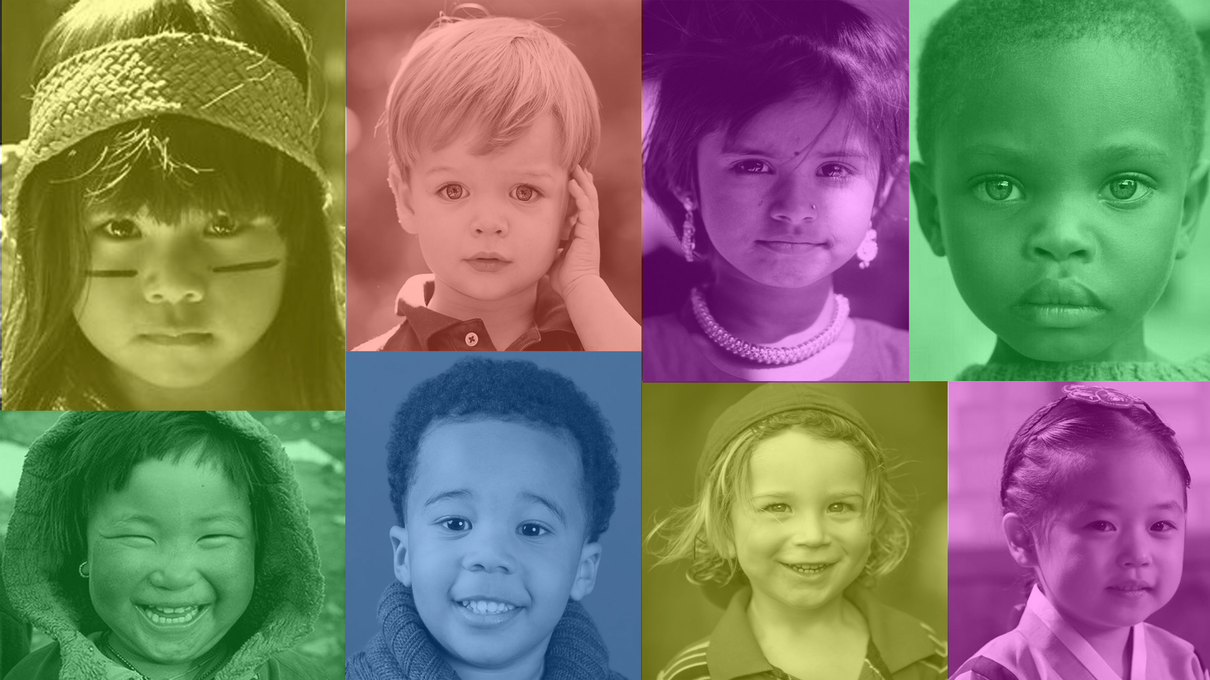
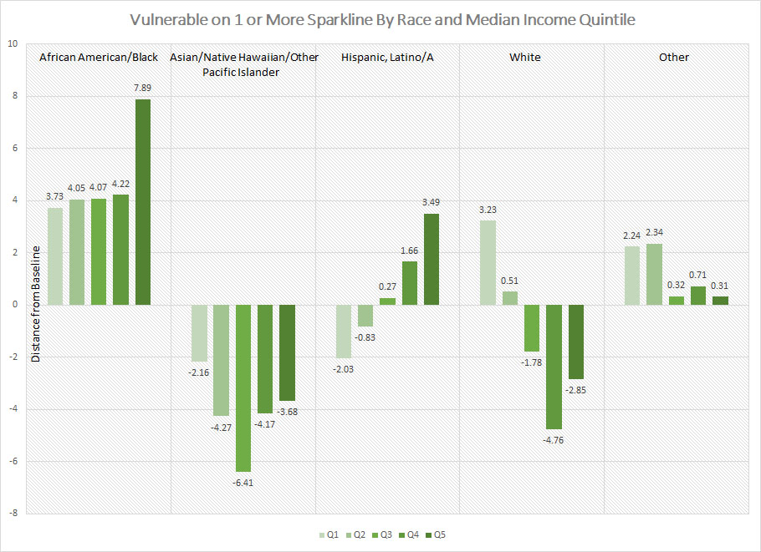
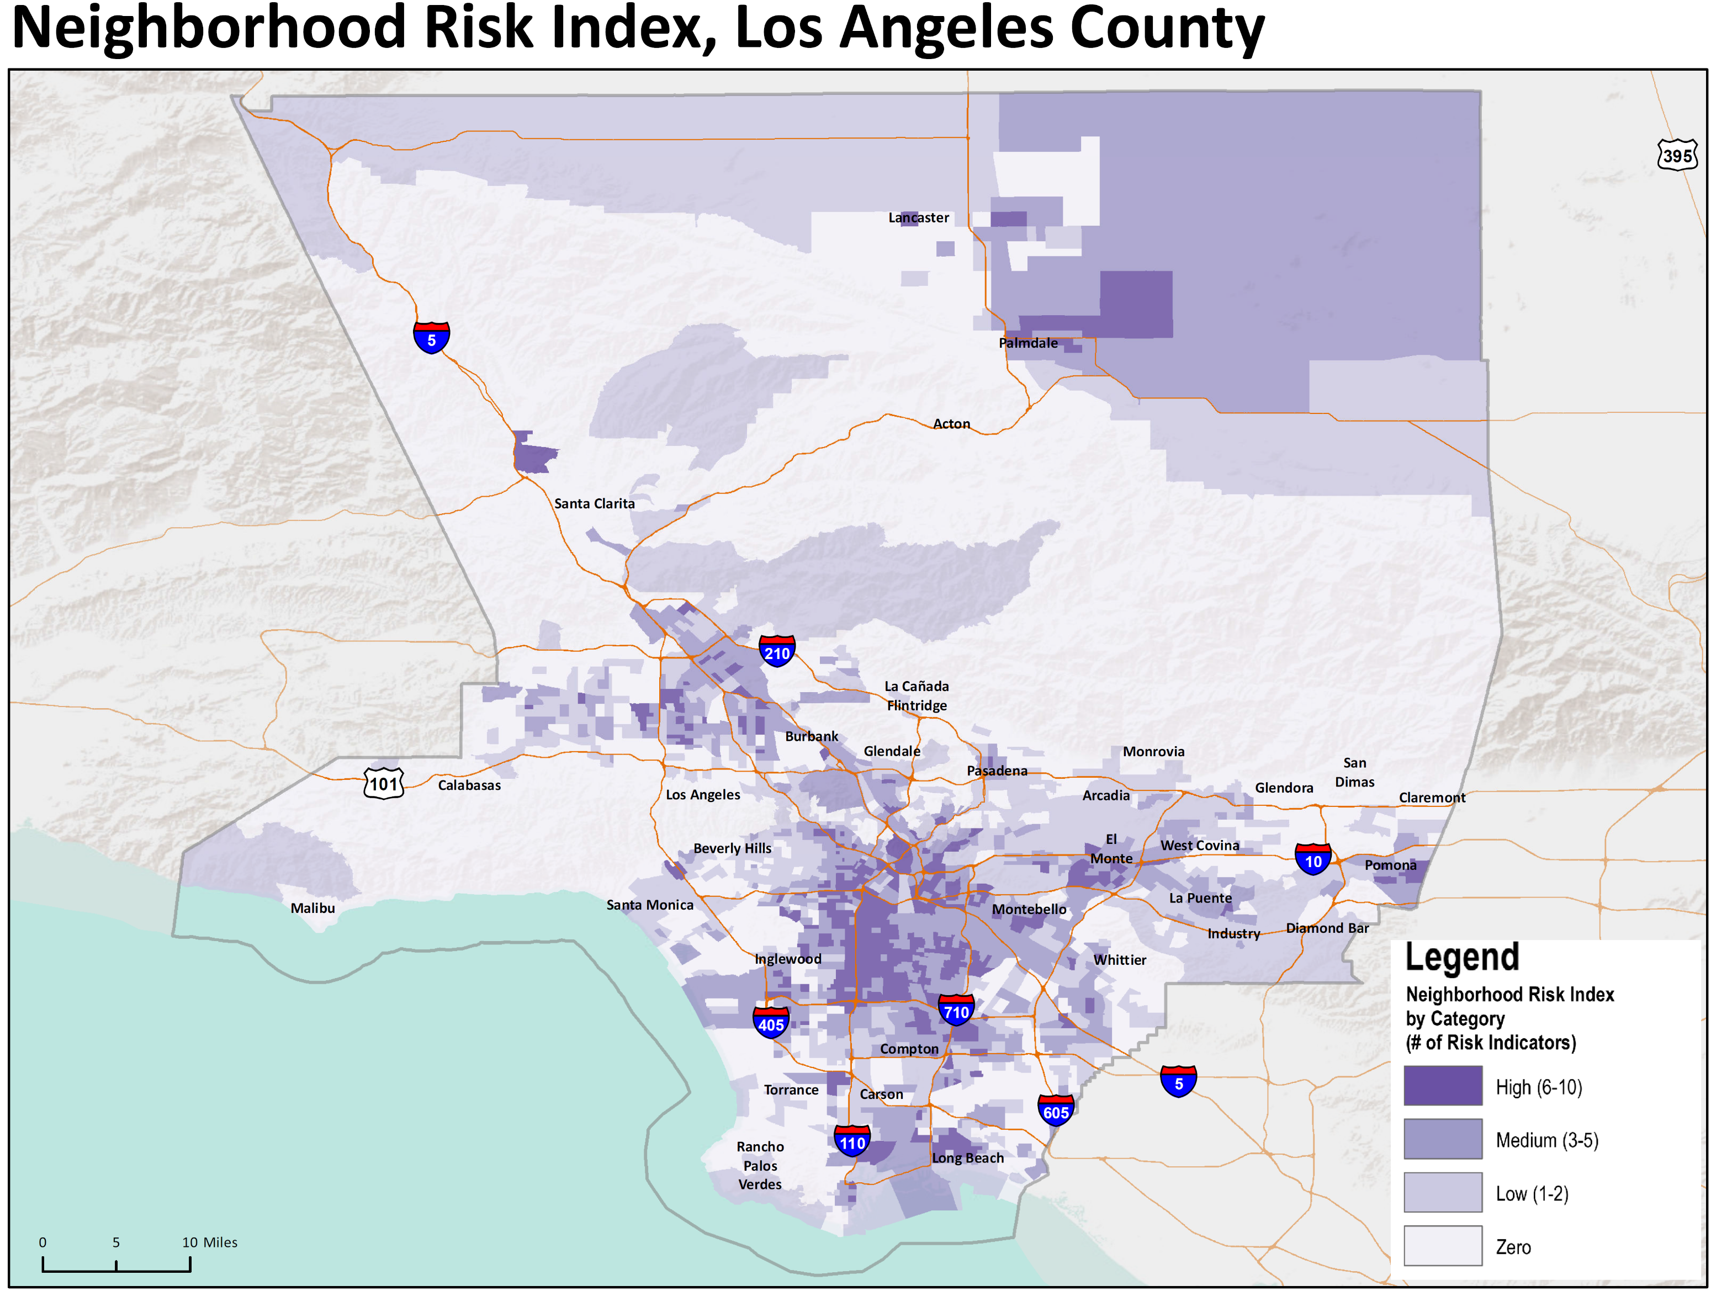
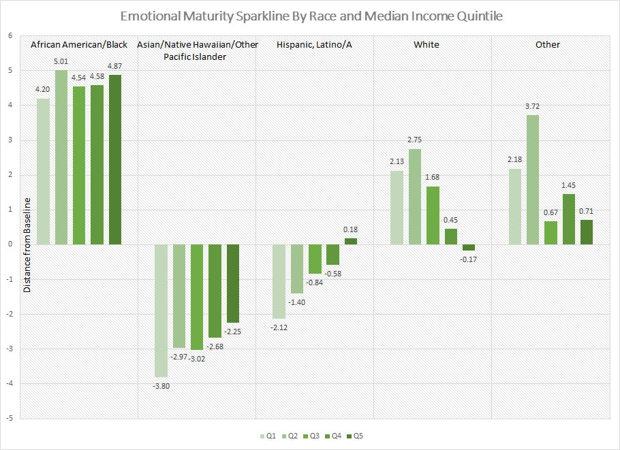
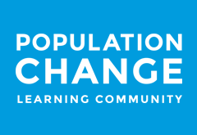
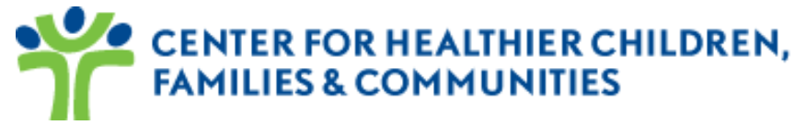
An Equitable Vision for Children & Families
Exploring Systems Innovation and Best Practices in the Prevention of Child Abuse and Neglect
Strategies 2.0 SoCal
Learning Community Convening
efren aguilar
GIS Unit Chief/Nerd/Change Agent

Slide 2
Before we begin…
Imagine a society with a fair and level playing field
Imagine systems of care that are perfectly designed to optimize the development of everyone
Consider while we are not yet there, we are closer today than we were yesterday…
    and we will be closer at the end of this discussion then we
    are now.

Slide 3
Special Thanks
UCLA Center for Healthier Children, Families and Communities: Transforming Early Childhood Community Systems Team
  Lisa Stanley, Josh Bader, Emily Chan, Jachael Gardner, Katie Barr, Neal Halfon
Doris Duke Population Change Learning Community
  Pat Bowie, Sara La Croix, Elena Fiallo, Liz Welch, Ron Brown, Lola Adedokun, Rumeli Banik, and all the member communities
ACT California Team
  Leila Espinosa, Jennifer Lopez, Charlene Choi, Eryn Block, Emily Cornell, Harold Goldstein, Flo Cofer, Kaytie Speziale, Reggie Caldwell, Mike Nguy, Lourdes Perez, Belinda Campos, Kaniyaa Francis
Pasadena, South LA, El Monte
All the brilliant folks that have contributed to this body of work and helped the framing, analyses, and direction for the future

Slide 4
Outline for Today
Epidemiological Review of Adversity
Lessons Learned and Emerging Findings
Review of EDI as a Population Measure of Child Well-being / Well-becoming
How to use population measures as a systems level diagnostic to:
  Map Spatial Inequity
  Graph Racial Inequity
All Children Thrive – California – Taking a glimpse past the horizon
Discussion: How can what we reviewed today be used to inspire transformational change to how we do business?

Slide 5

Acknowledgements
Bringing the Science
Dr. Urie Bronfenbrenner
Dr. Charles Bruner
Dr. Neal Halfon
Dr. Magdalena Janus
Dr. Dan Offord
john a. powell
Dr. Robert J. Sampson
Dr. David R. Williams
Dr. Howard Pinderhughes
Bringing the Art
Stevie Wonder
  Living for the City (1973)
Grandmaster Flash and the Furious Five
  The Message (1982)
Ice-T
  Colors (1988)

Slide 6
One more thing…
These data and information are presented with humility – answers to our questions will likely lead to more questions
Before we begin, we want to activate your neuroplasticity – brain calisthenics
Would like to orient you to 3 conceptual pillars to help you on your own journeys
  Think Spatially
  Act Locally
  Learn Collectively

Slide 7
Part 1: Epidemiological Review of Adversity
“So long as these kinds of inequalities persist, all of us who are given expensive educations have to live with the knowledge that our victories are contaminated because the game has been rigged to our advantage.”
- Jonathan Kozol

Slide 8
Traditional Causes of Adversity in Childhood
Poverty, social isolation, marginalization, exclusion and inequality
Racism, discrimination,
Family dysfunction, conflict, & despair
Untreated, uncontrolled mental health problems
Drug, alcohol and other substance abuse issues
Natural disasters, extreme weather events
Unforeseen & uncontrollable family separations, divorce
Death of parents, family member

Slide 9
Deep Drivers of New Forms of Adversity
Change of age (economies/ production ecosystems)
  agriculture> industrial> IT
Major disruptions in our social ecosystems
  cultural forms, value streams, production models, relationship to environment/planet
Accelerators of change
  Globalization X Technology X Climate Change
  Other Megatrends – urbanization, inequality, migration
Speed of change accelerating (faster than we can adapt to; disease and disability due to adaptive failures)
Mismatches -- Human development> Family Development> Community Development> Economic Development
Disruptive conflicts, changing lifecourse pathways, instability, insecurity, are here to stay

Slide 10
Changing Pattern of the Epidemiology of Adversity
Increase in chronic health problems (40%)
Growing prevalence of mental health disorders (22+%)
Greater appreciation of role and impact of neuro-developmental health problems – learning, language (10-17%)
Growing number of children with multiple conditions (co-morbidities) e.g. asthma, obesity, ADHD
  Syndemics?

Slide 11
Challenging Times for Children & their Future Health
Persistent, structurally resistant levels of child and family poverty (US 48% of young kids in low income families)
Growing & solidifying inequality, rising levels of adversity (relative to context)
Rapidly changing epidemiology, slowly adapting health care systems
Dominance of adult, cost driven health care policy, and rapidly-deployed market-driven reforms
Intractable SES gaps – infant mortality, child morbidity, school readiness, high school graduation life expectancy complicated further by racism and despair
Incremental mindsets in face of problems that demand transformative changes (fixit, incremental vs. transformative)

Slide 12
Part 2: Lessons Learned and Emerging Findings
“The secret of change is to focus all of your energy, not on fighting the old, but on building the new.”
- Socrates

Slide 13
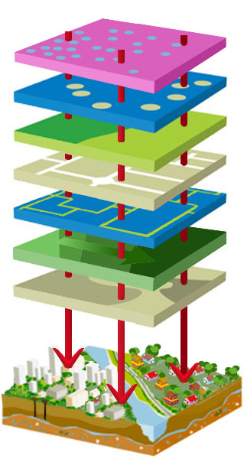
Neighborhoods are key units of change
Child
1
Child
2
Child
3
Measurable Developmental Outcomes
Crime
Access to Supportive Services
Socio-Economic Conditions
Built Environments
Strong Neighborhood Relationships
Socio-Historical Context
Topography
Examples of Spatial Factors Impacting Early Childhood Development

Slide 14
Population Measures and the Importance of Place
It’s Complex¹
  Environmental influences are varied and include social and physical factors
  These individual factors interact with each other and sometimes mediate or exacerbate outcomes
  The strength of the influence changes over the life course (inter-generational, prenatal, perinatal, infancy, early childhood, etc.)
It’s Difficult to Measure
  Policy changes can interrupt surveillance efforts
  Causation is hard to prove
Sampson, Robert J., et al. “Assessing ‘Neighborhood Effects’: Social Processes and New Directions in Research.” Annual Review of Sociology, vol. 28, 2002, pp. 443–478. JSTOR,
www.jstor.org/stable/3069249.

Slide 15
It’s Time to Rethink
Not only about services but also about systems
Embrace Complexity
  Communities are complex, growing, developing ecologies
Scale the Change Needed
  Big problems in complex system are not going to respond to incremental changes
Complex Systems Learn their way Forward
  Need a Learning System to foster adaptive change
Systems perform better when services and sectors are aligned and user friendly and where adaptive innovation and improvements are normative

Slide 16
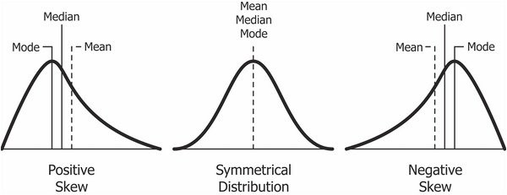
Marginal Risk Strategies Used to be More Viable
When Risks were Normally Distributed
At Risk
Population
% of Population
Level of risk
High
Normal
Low
Source: Rose G. Sick Individuals and sick populations. Int J Epidemiol, 1985; 12:32-38.

Slide 17
Now that Risk Distribution is Skewed
Population Strategies are Needed to Shift the Population Curve
At Risk
Population
% of Population
Level of risk
High
Normal
Low
Source: Rose G. Sick Individuals and sick populations. Int J Epidemiol, 1985; 12:32-38.

Slide 18
Life Course Development
Toxic Stress
Lack of health services
“Healthy” Trajectory
Poverty
“At Risk” Trajectory
Readiness to learn
Pre-school
Health Services
“Delayed/Disordered ” Trajectory
Appropriate Discipline
Reading to child
Parent education
Emotional Health
Literacy
Late Infancy
Late Toddler
Late Preschool
Birth
6 mo 12 mo 18 mo 24 mo 3 yrs 5 yrs
Age
Early Infancy
Early Toddler
Early Preschool
Halfon, N., Larson, K., Lu, M., Tullis, E., & Russ, S. (2014). Lifecourse Health Development: Past, Present and Future. Maternal and Child Health Journal,18(2), 344–365. http://doi.org/10.1007/s10995-013-1346-2

Slide 19
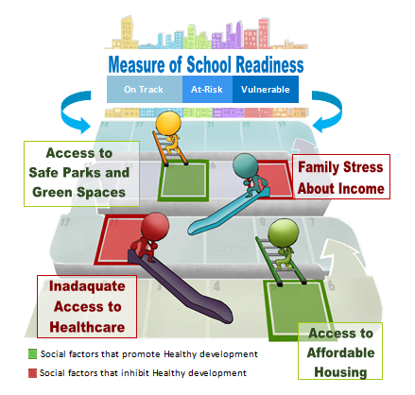
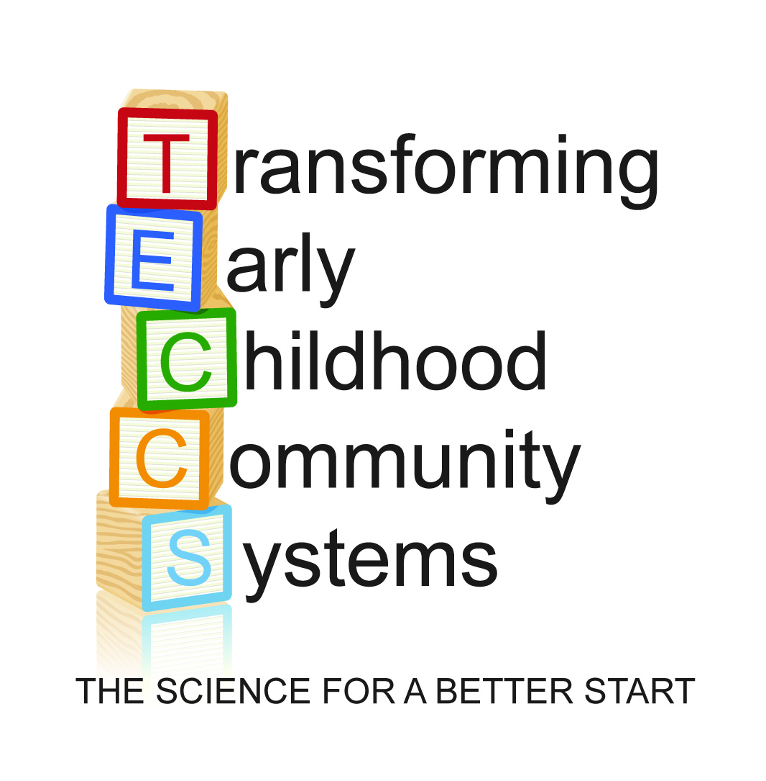
What does this look like at the neighborhood level?

Slide 20
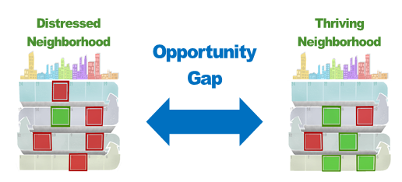
This raises questions around equity…

Slide 21
Part 3: Review of EDI as a Population Measure of
Child Well-being/Well-becoming
“Everything is related to everything else, but near things are more related than distant things.”
- Waldo Tobler

Slide 22

EDI Characteristic Highlights
Holistic measure
Covers five developmental domains, 16 subdomains
Feasible to implement at scale
Collected once every 3 years by K teachers online, recall
Internationally validated
Developed at McMasters University, Canada
Successfully used in over 15 countries, across Canada, national indicator in Australia
Strong reliability and validity
EDI Predicts later standardized test scores

Slide 23
5 Developmental Domains
Communication Skills
Physical Health & Well-Being
Ability to use language
Communicate needs and understand
Motor skills
Physical readiness
Language &
Cognitive
Social Competence
Abilities with reading, writing, numbers, shapes
Getting along with peers,
Respect for others
Emotional Maturity
Emotional wellbeing, feeling sad, fearful, etc

Slide 24
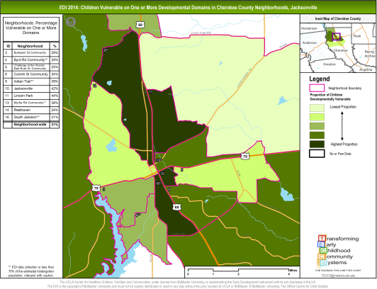
Population
A community snapshot of children’s healthy development and school readiness. Not reported at an individual child level.
Informs place-based efforts to optimize the healthy development for all young children
Results are used to
  Look back to help collective efforts to prepare children for school
  Look forward to optimize children’s success as they progress through school
Look Back
Look Forward

Slide 25
Part 4: How to Use Population Measure as
A Systems Level Diagnostic Metric
“Every system is perfectly designed to get the results it gets.”
- W. Edwards Deming

Slide 26
Conceptual Framework: Important Dimensions to Consider in Developing Your Data Systems
There are multiple factors and functions at play in any given community
Although this is mostly being studied using complexity science theory¹ in order to speak about this practically and quantitatively we need to disaggregate neighborhood qualities along different dimensions of measures
Community Contextual Factors
Resident Collective Efficacy
Population Health Results
Community Systems Functioning
1. https://www.uvic.ca/research/groups/cphfri/assets/docs/Complexity_Science_in_Brief.pdf
Notes:
Community Contextual Factors: Known observable and measurable factors that have been correlated with and/or predict population health outcomes
(Neighborhood Risk Index)
Resident Collective Efficacy: Is a concept that refers to the ability of members to act on and mitigate the behaviors of individuals and groups within their communities to facilitate social order
Resident Agency/Leadership Workgroup
Improving Community Wellness Measures
Community Systems Functioning: Refers to the collective impact of the social service providers, public and private sector agencies, and business to positively impact population health outcomes
Strengthening Collective Capacity Workgroup

Slide 27
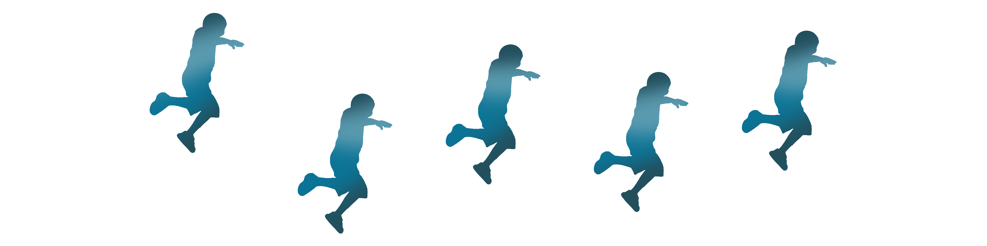
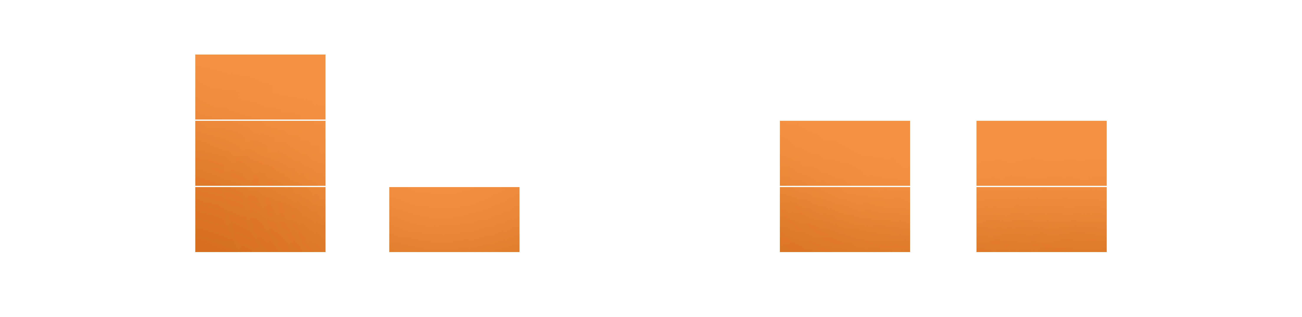
Caution about Using Population Outcomes without Contextual Data
Performance on EDI
- On-Track
- At-Risk for being Vulnerable
- Vulnerable

Slide 28
Overview of the Neighborhood Risk Index (NRI)
Percent Single Parent
Percent Poor Families with Children
Percent 25 + no High School Diploma
Percent 25+ BA or Higher
Percent 16-19 not School/Work
Percent Head of Household on Public Assistance
Percent Head of Household with Wage Income
Percent Head of Household Interest, Dividend or Rent Income
Percent 18+ Limited English
Percent Owner-occupied Housing
Bruner, C. (2017). ACE, Place, Race, and Poverty: Building Hope for Children. Academic Pediatrics, Volume 17 , Issue 7 , S123 - S129
https://doi.org/10.1016/j.acap.2017.05.009

Slide 29
Neighborhood Classification
All census tracts from counties where we have collected EDI were classified into 4 groups
  Zero: No Vulnerability Factors
  Low: 1-2 Vulnerability Factors
  Medium: 3-5 Vulnerability Factors
  High: 6-10 Vulnerability Factors

Slide 30
Mapping Spatial Inequity

Slide 31
Neighborhood Risk Index (NRI) Performance by EDI Domain

Slide 32
Mapping Bruner’s Index with the EDI
Census tracts performing poorer than expected on the EDI Negative Deviance
 | Number of CTs | %
 | 46 | 2%
 | 146 | 5%
 | 371 | 14%
 | 1,469 | 55%
 | 417 | 16%
 | 176 | 7%
 | 43 | 2%
EDI Vulnerability | Highest
 | Lowest
 |  | Zero | Low | Medium | High
 |  | Bruner Vulnerability Class
Census tracts
Performing better than expected on the EDI Positive Deviance

Slide 33
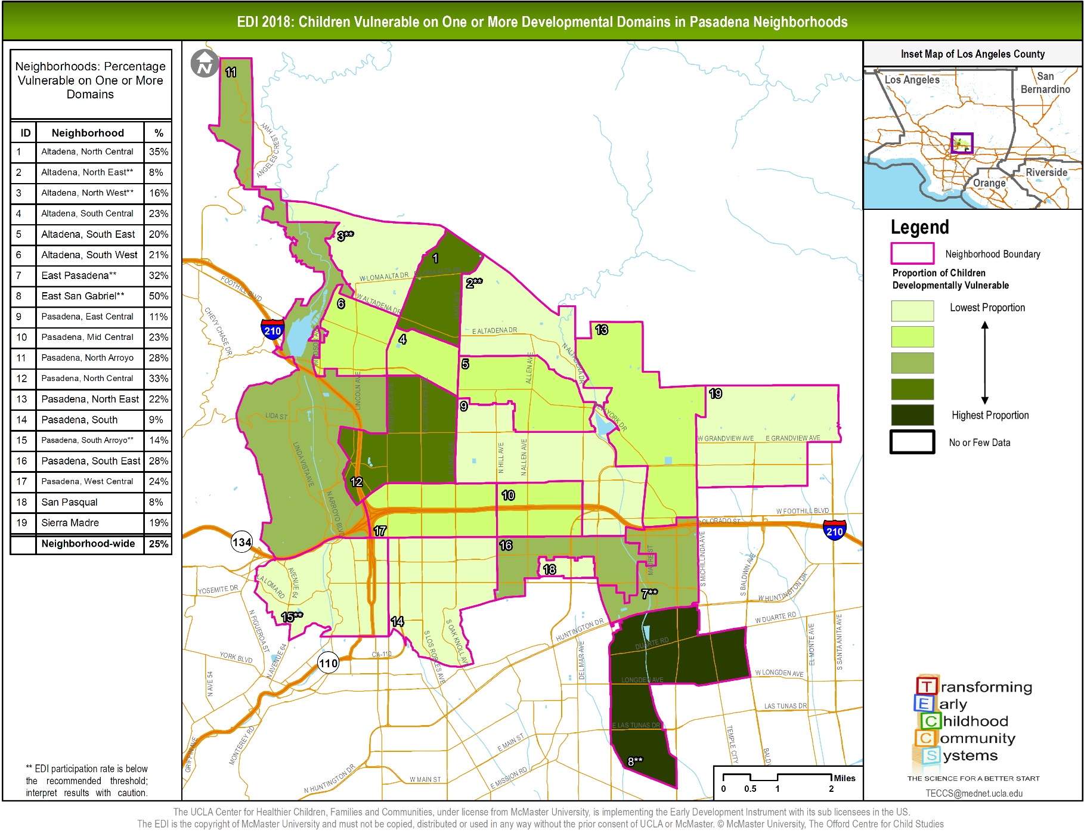

Slide 34
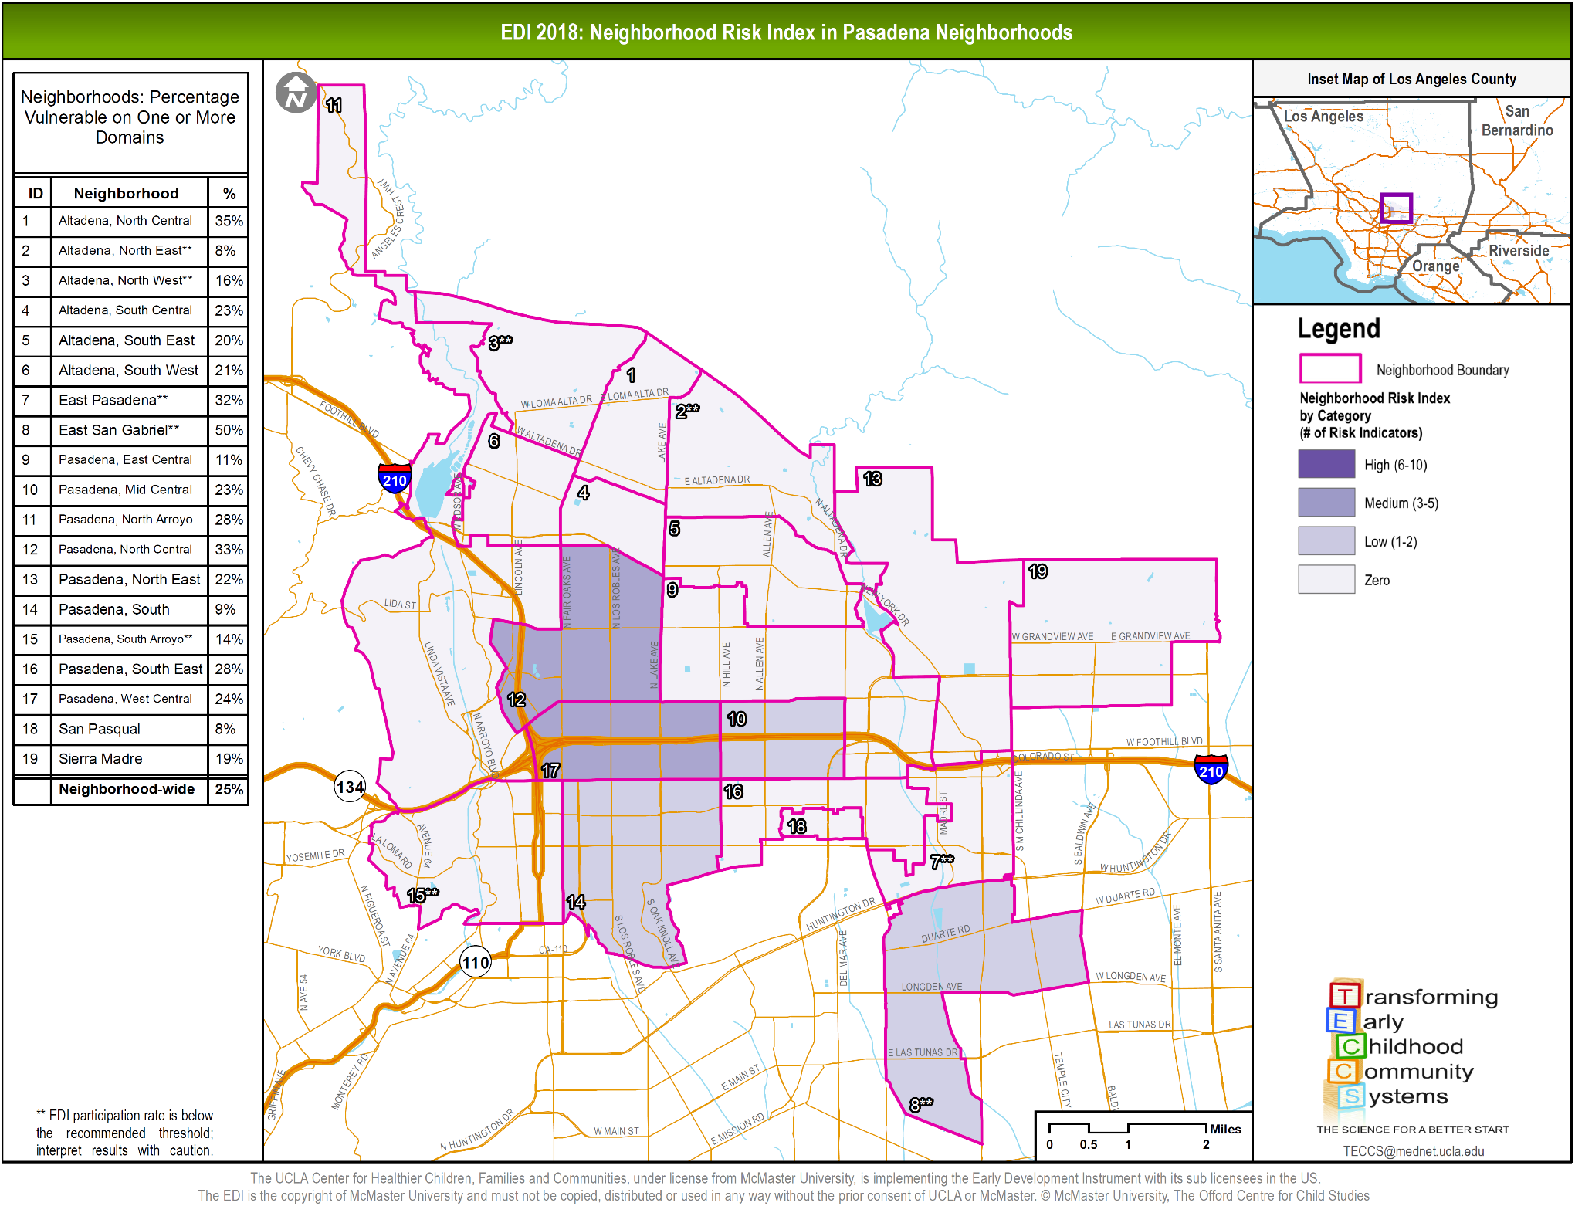

Slide 35
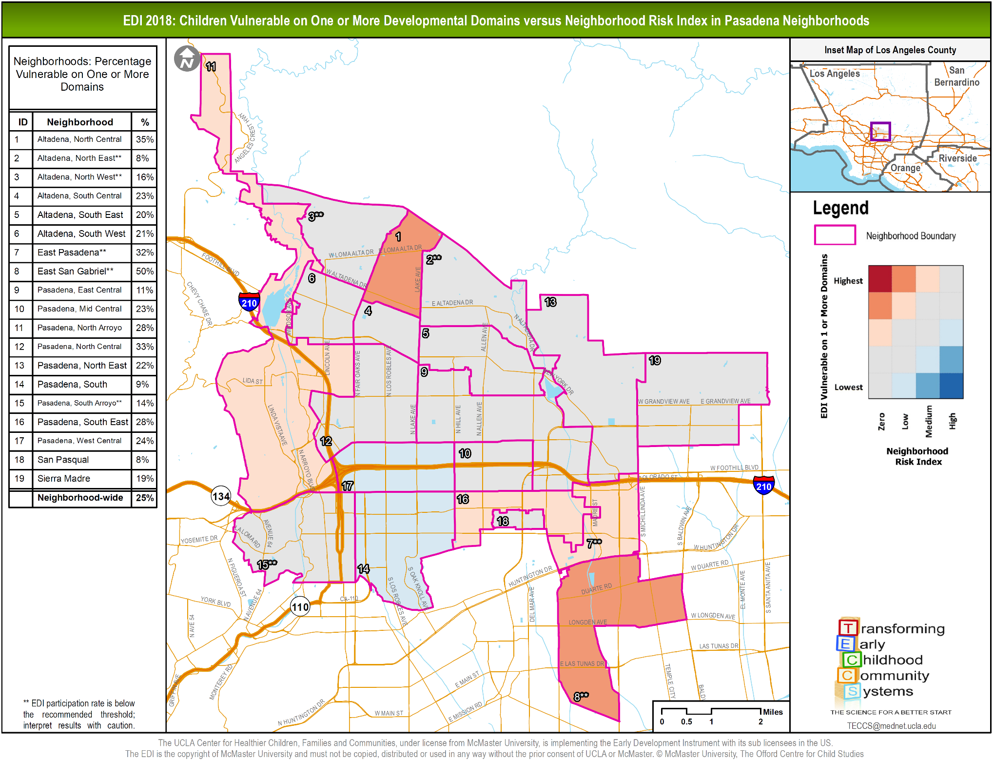

Slide 36
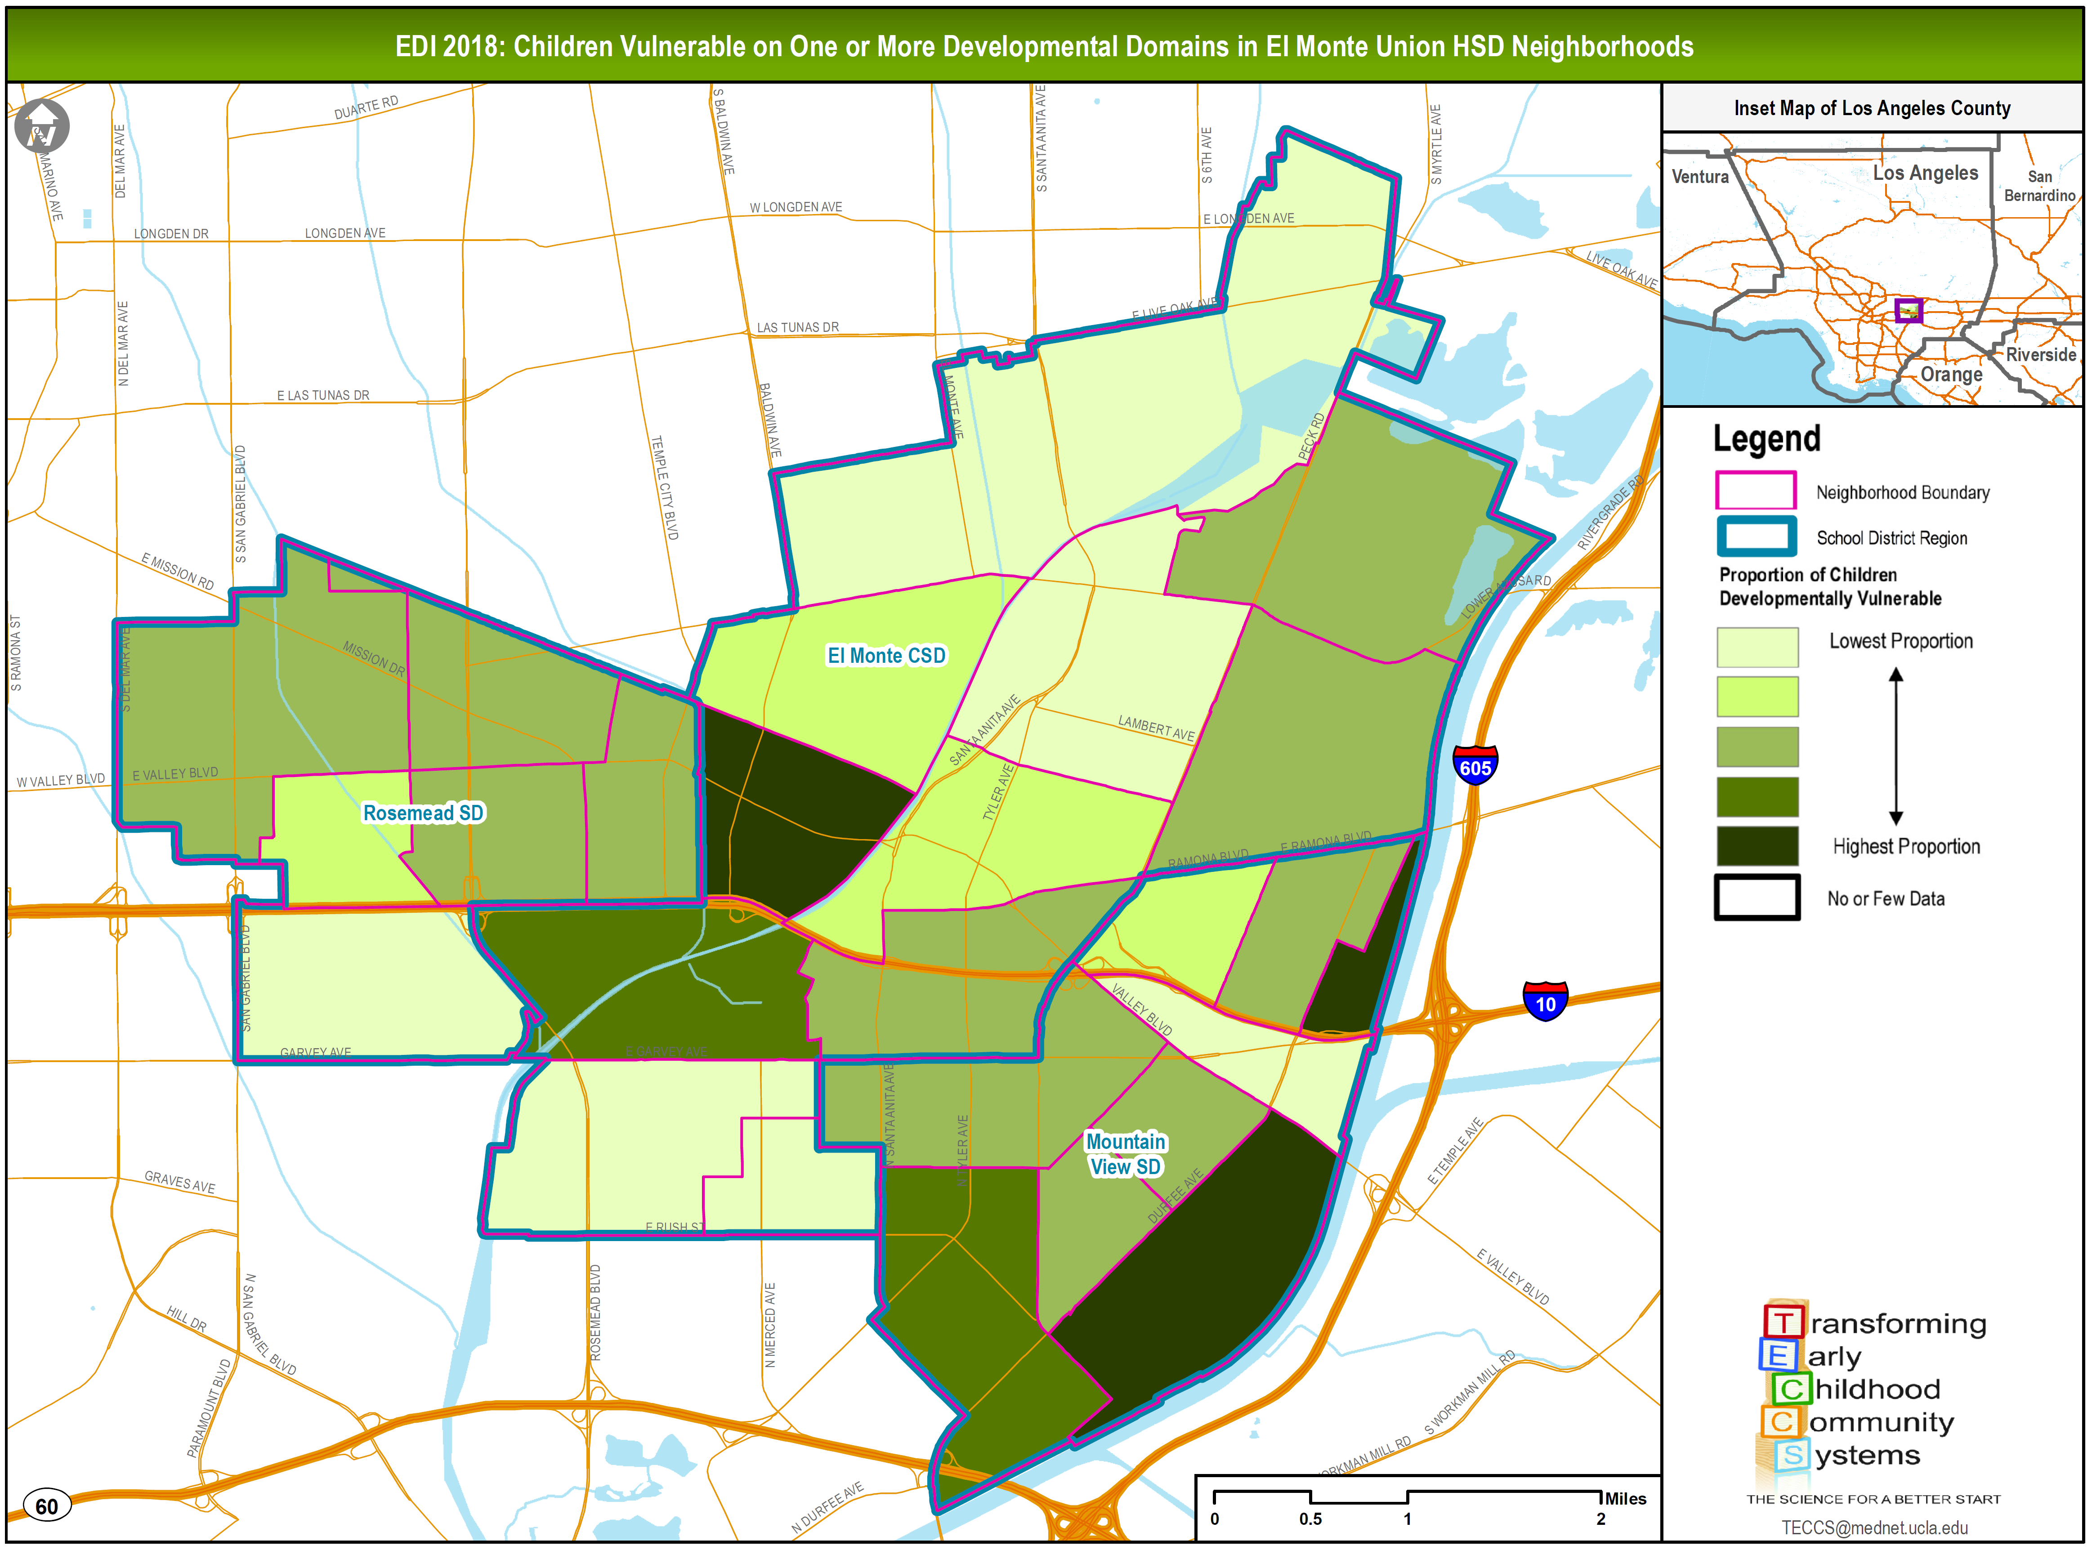
Notes:
One of our communities in the El Monte area of LAC.
This is a regional effort and collaboration of partners including 3 SD (El Monte, Rosemead and Mountain view), El Monte Promise collective group and the Jeff Seymour Family Center
This map reflects data collected from those three school districts.
Children mapped to where they live – not where they go to school
Green
Patterns
Disparity
Cumulative risk but what are the relative strengths and challenges for each neighborhood
Most risk have different profiles

Slide 37
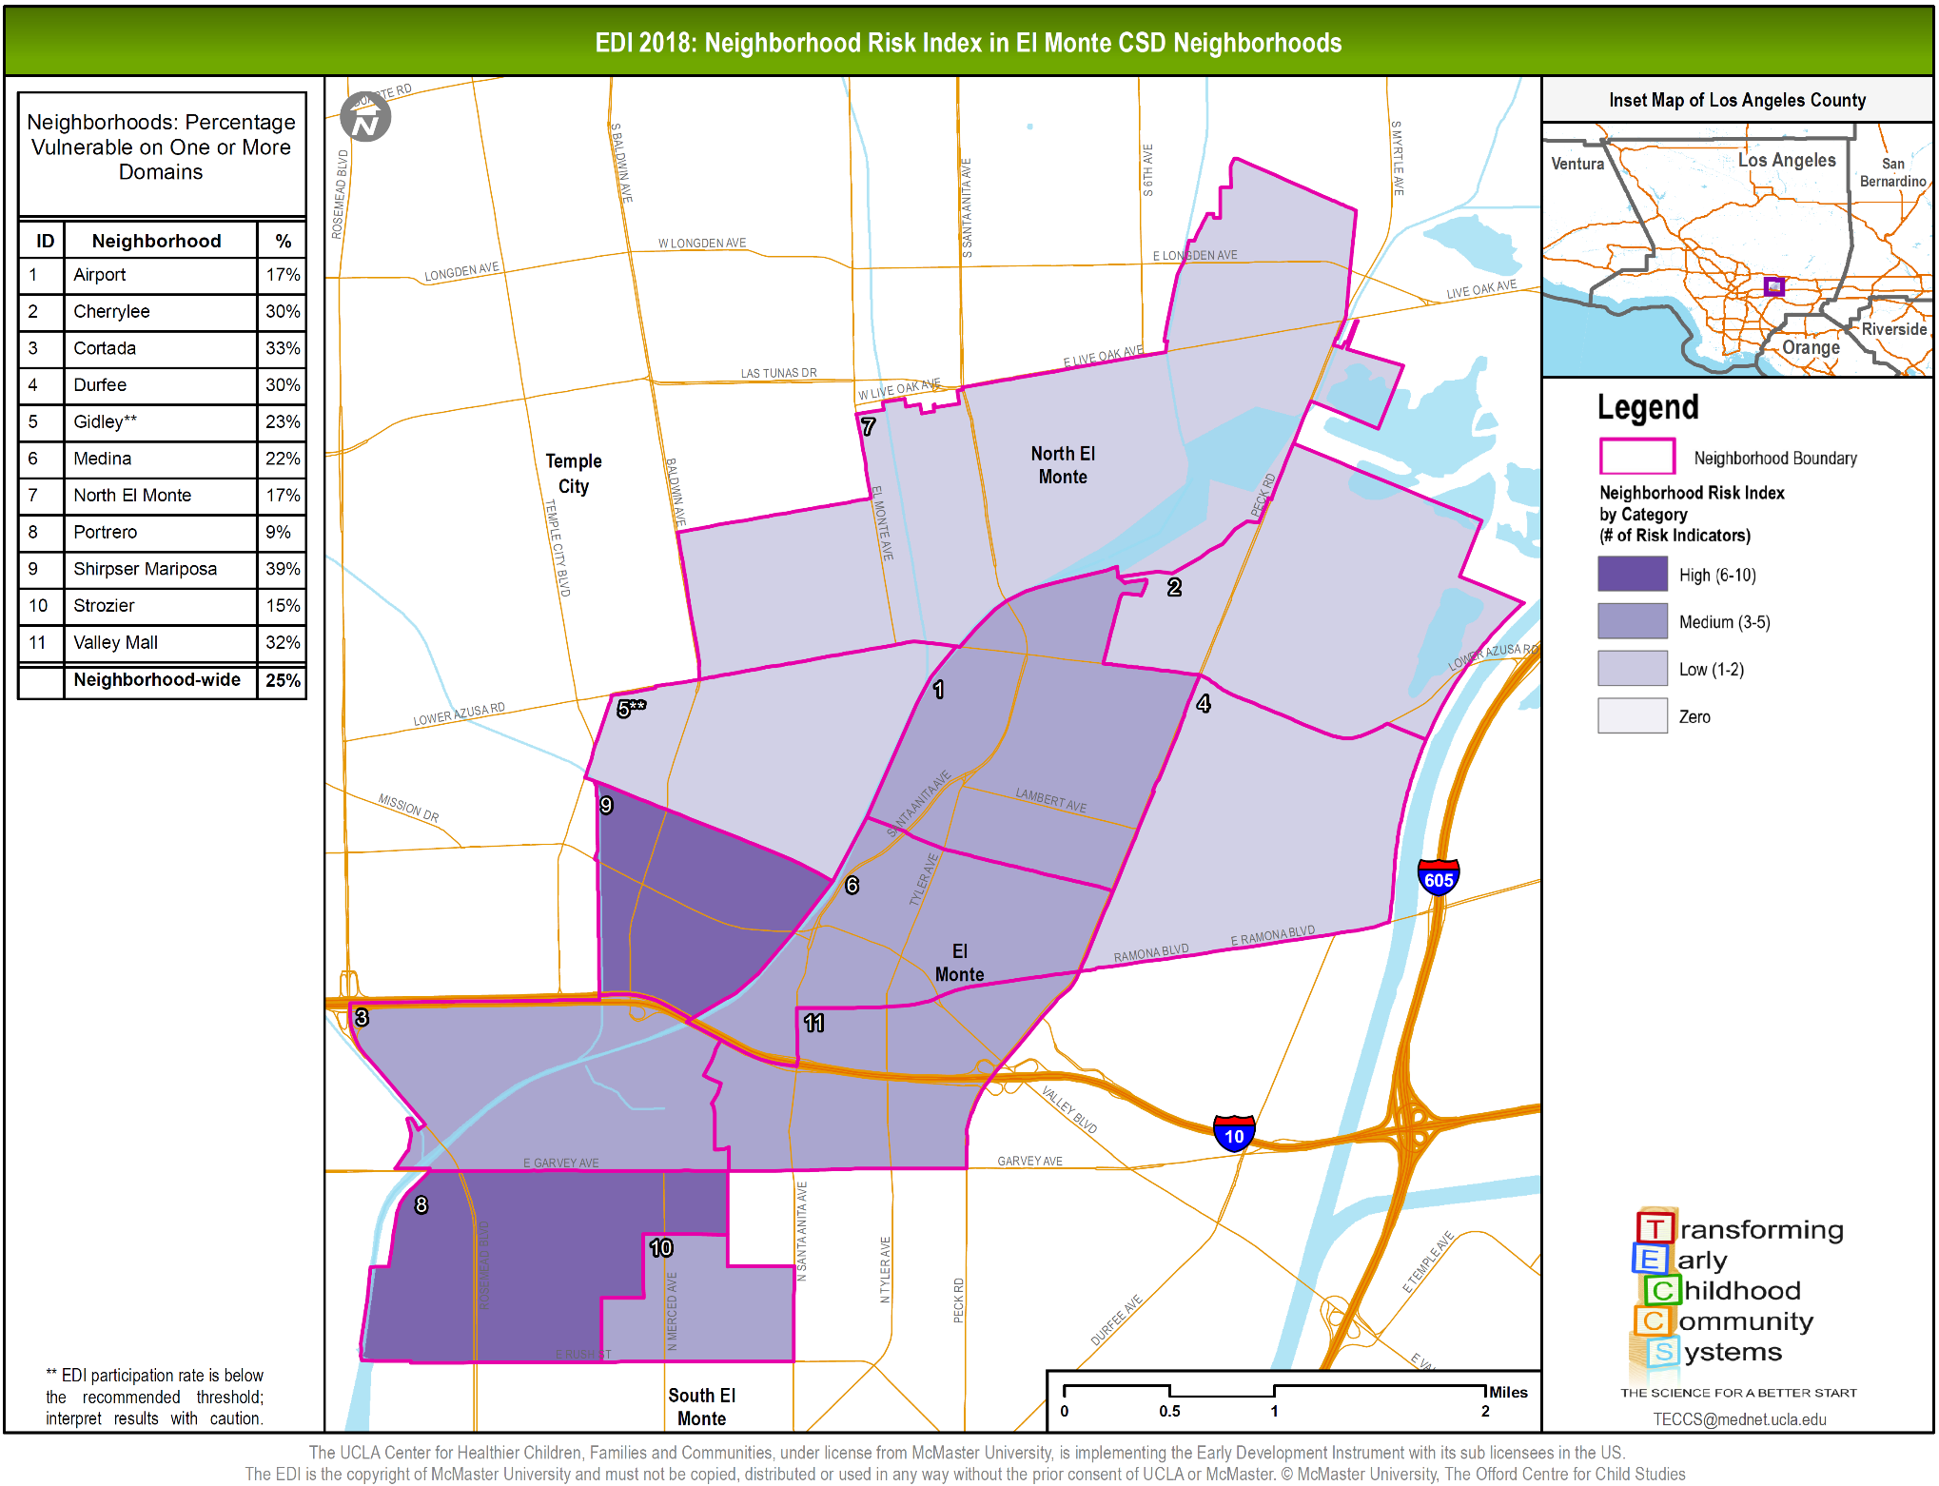

Slide 38
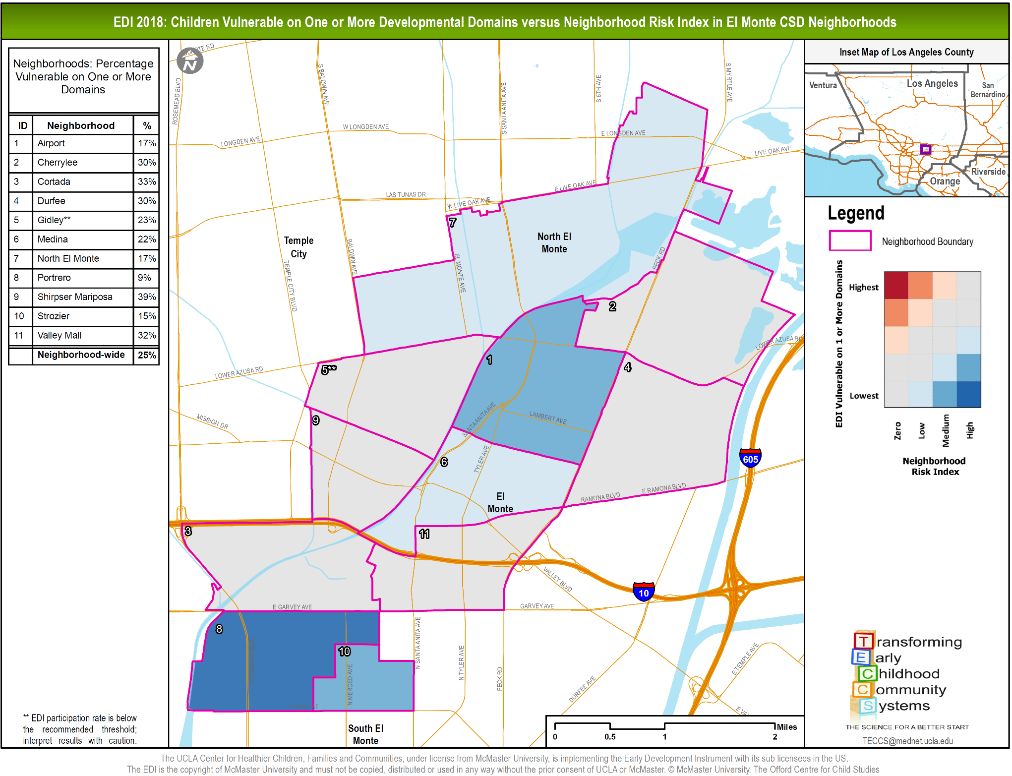

Slide 39
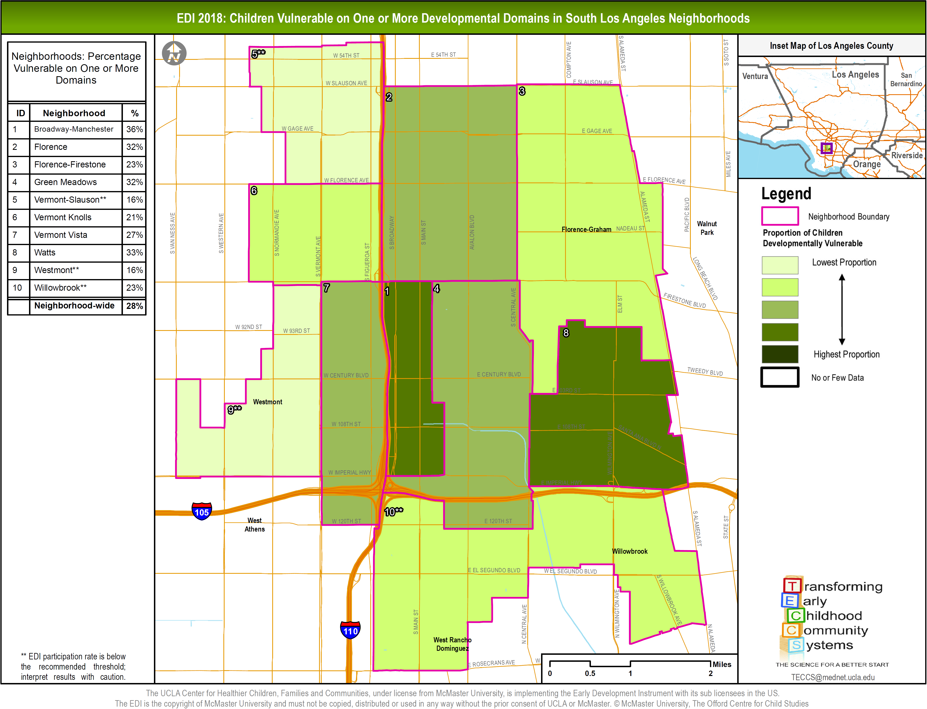

Slide 40
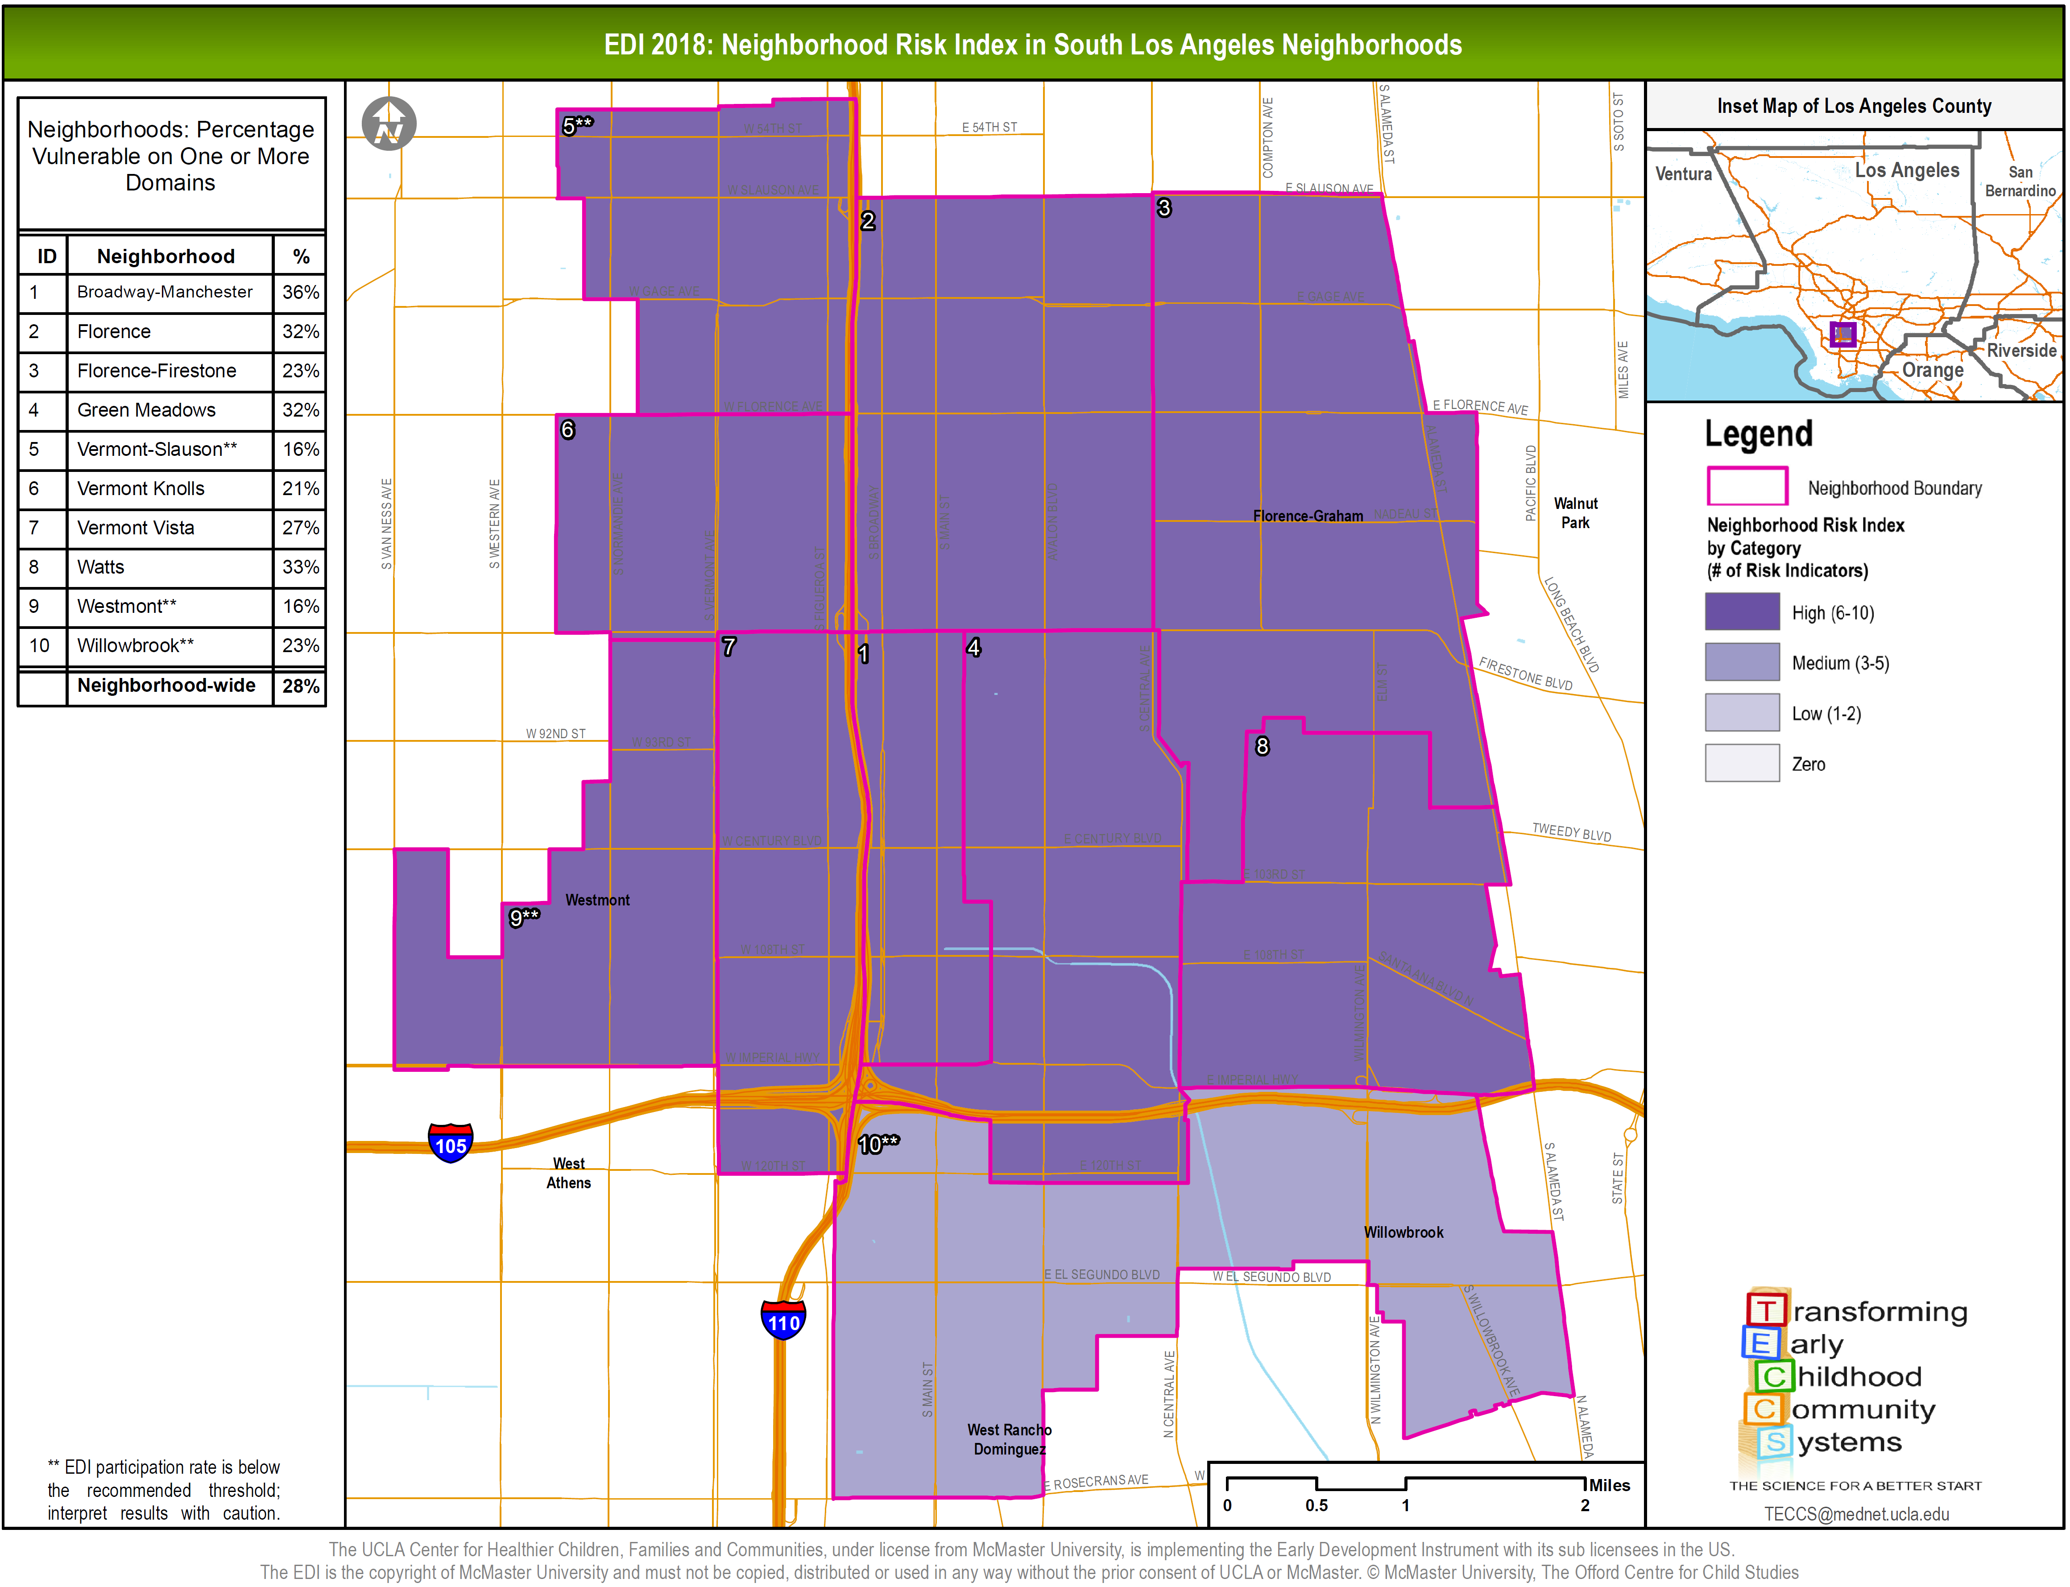

Slide 41
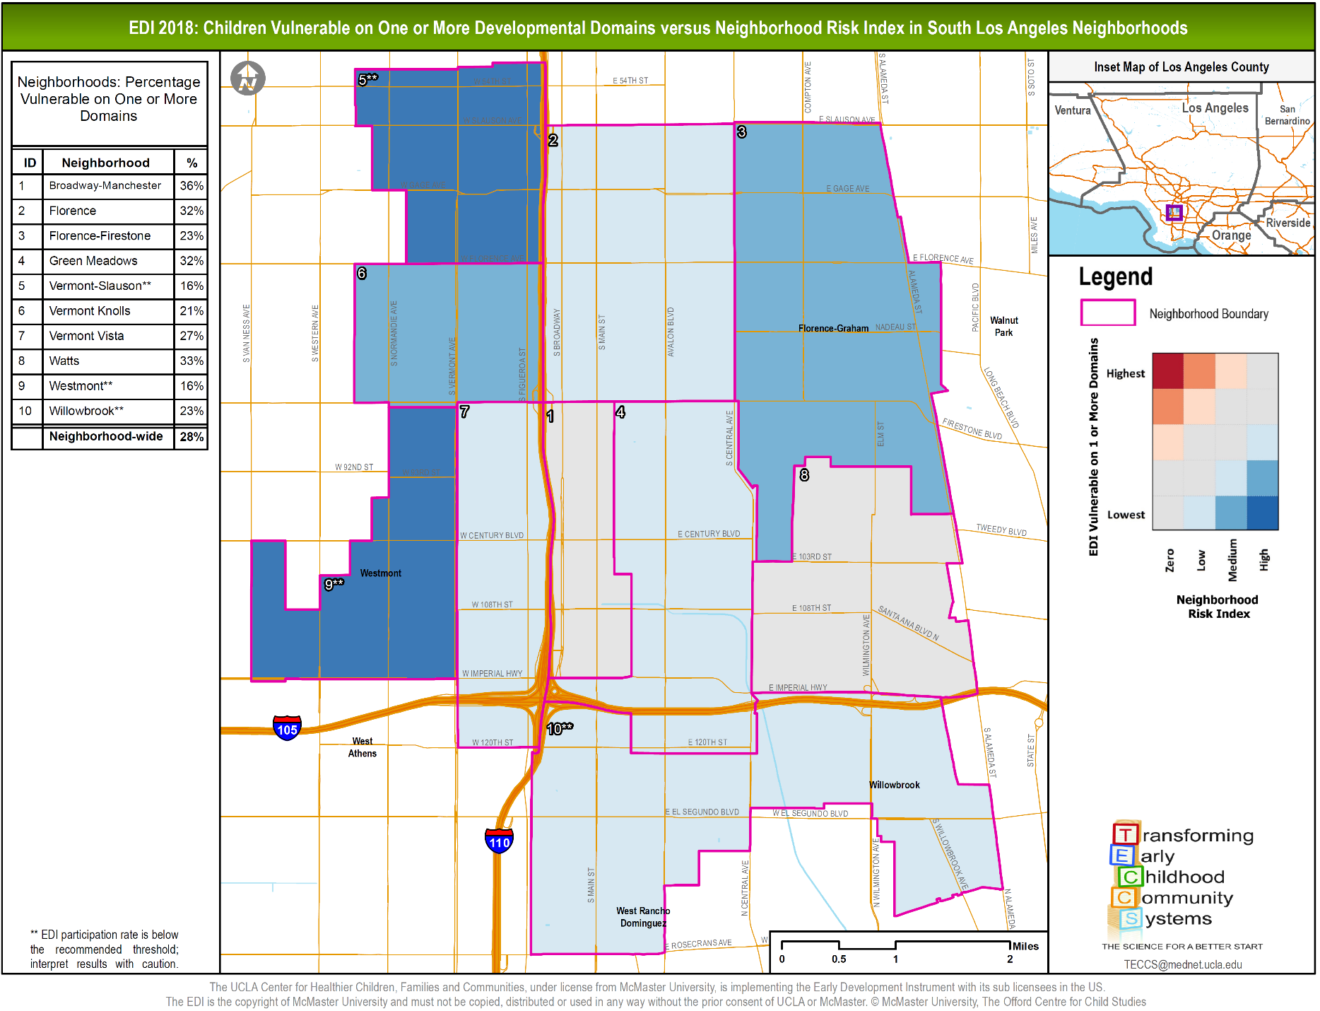

Slide 42
Revised Analyses Can Compare Expected Outcomes Based on Local Context – and provide a way to facilitate cross site learning and dialogue
-3
Proportion of EDI Vulnerability | Highest
 | Lowest
 |  | Zero | Low | Medium | High
 |  | Level of Neighborhood Risk
-2
Expected
-1
+1
+2
Expected
+3

Slide 43
Graphing Racial Inequity

Slide 44
Poorest
Wealthiest
These data suggest a relationship between the percentage of kids on vulnerable developmental trajectories and median income for the census tracts in which they reside.
This pattern is noticeable on cumulative assessments and individual developmental domains.
Percentage of Kids on Vulnerable Developmental Trajectories
Median Income by Quintile

Slide 45
So – The question about race/ethnicity…
Interpreting the previous chart elicits a few questions on how this analysis looks when you disaggregate the data by race/ethnicity.
  Will the relationship/pattern remain the same?
  Are some populations more vulnerable to the effects of community level poverty?
  Are other populations more resilient to the effects of community level poverty?
  Finally, do families in prosperous communities all have the same levels of advantage, or do they differ across racial/ethnic groups

Slide 46
Percentage of Kids on Vulnerable Developmental Trajectories
Looking at the data broken out by race, we see that the general pattern remains the same (a decrease in the proportion of kids on vulnerable developmental trajectory as median income for the census tracts in which they reside increases).
However, (when broken out by race) we see that although living in higher income neighborhoods reduces the percentage of kids on vulnerable developmental trajectories, the degree of the slope changes for children of different race/ethnicities.
We can measure and graph this difference for each race/ethnicity using a Race/Ethnicity Equity Gap calculation.
Median Income by Quintile

Slide 47
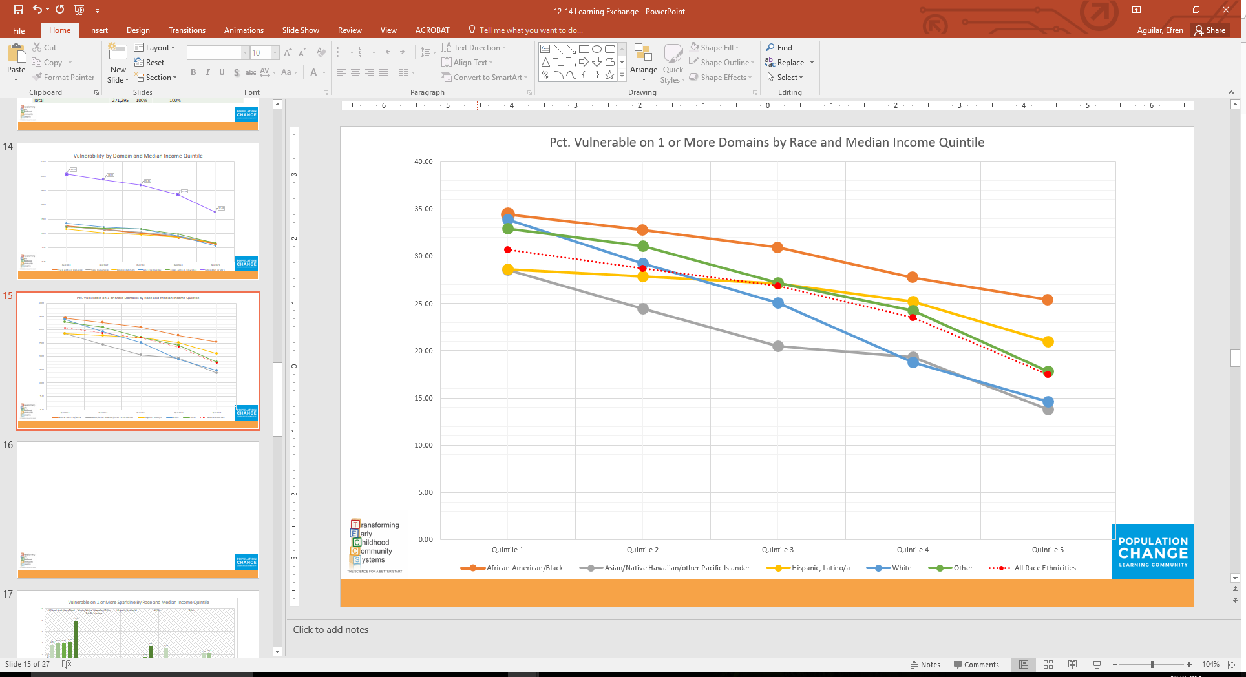
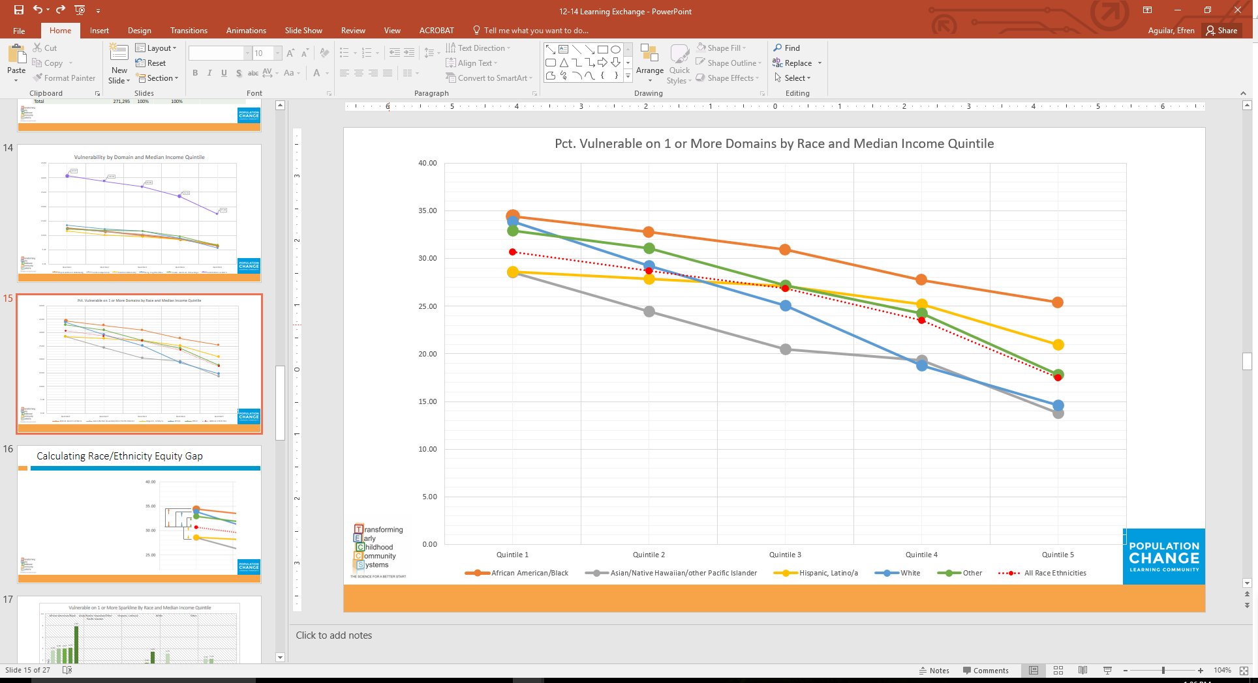
Calculating Race/Ethnicity Equity Gap (REG)
Race/Ethnicity Equity Gap
Derived by calculating the distance between
% Vulnerable of All Race/ Ethnicities and
% Vulnerable for each individual Race/Ethnicity across each Median Income Quartile
Example:
% Vulnerable All Race/Ethnicities
– % Vulnerable African American/ Black)
REG African American/Black
REG
REG
REG
REG

Slide 48
Visualizing the Race/Ethnicity Equity Gap
African American/Black (Example)
Percentage of Kids on Vulnerable Developmental Trajectories
Q1
Gap
Q2
Gap
Q3
Gap
Q5
Gap
Median Income by Quintile

Slide 49
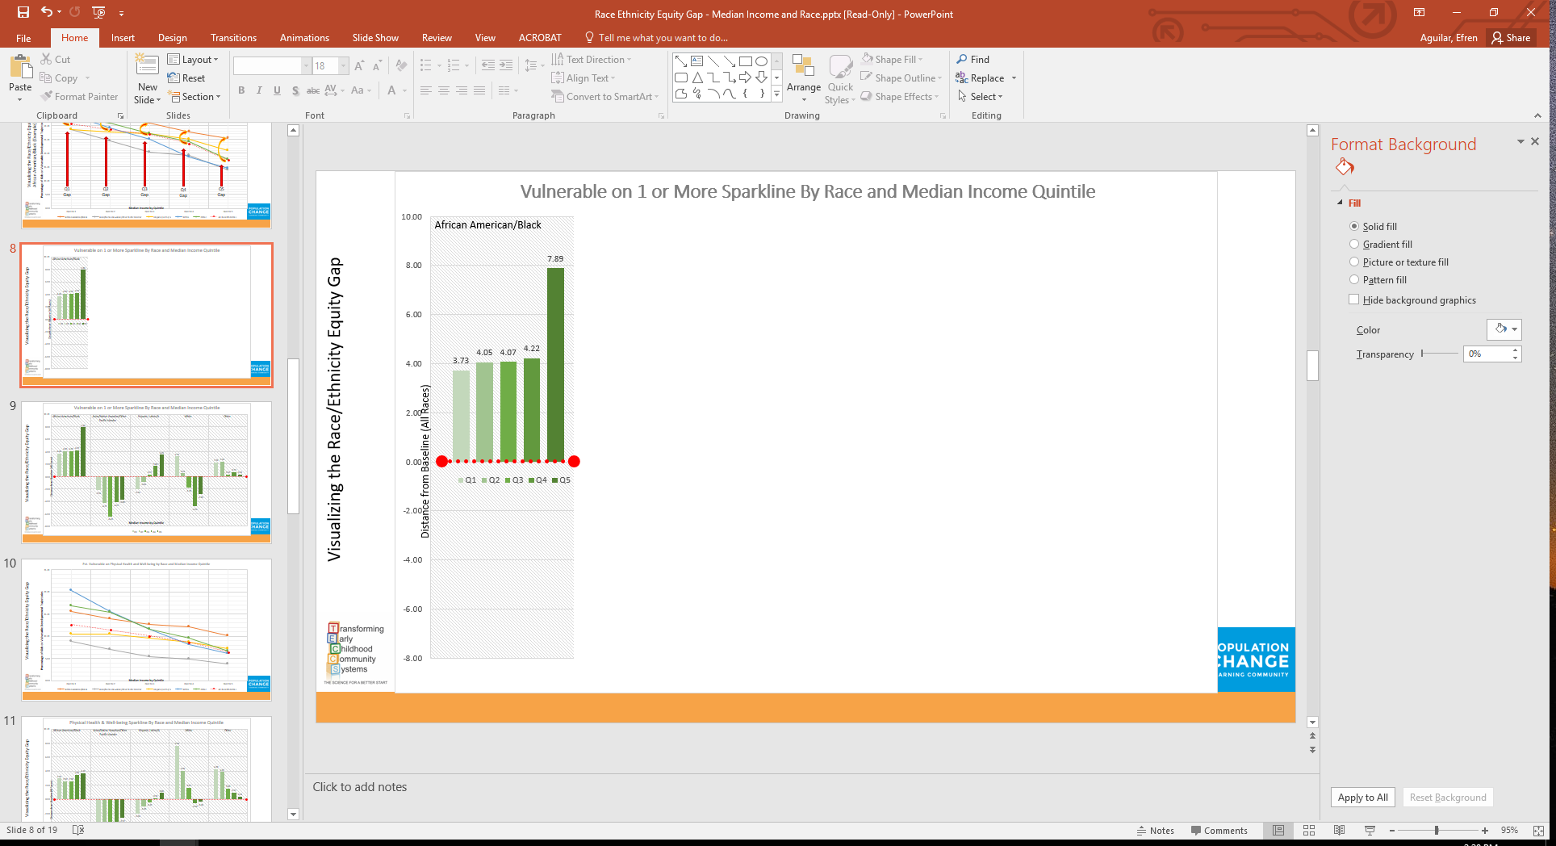
The length of the bar is based on the difference between the African American/Black population and All Race Ethnicities.
The red dotted line represents All Race/Ethnicities (as seen in the line graphs) and is the zero point in these graphs.
Each bar represents the median income quintile and are distinguished by the shade of green (lighter shades are lower median income and darker shades are higher median incomes).
Visualizing the Race/Ethnicity Equity Gap
REG Calculation

Slide 56
Part 5: All Children Thrive
“Health Systems are in the midst of a transformation from the 1.0 version that was focused on prolonging life through acute care, injuries, and infectious diseases, to the currently evolving 2.0 systems that is focused primarily on avoiding disability though chronic disease treatment and management, to the 3.0 system that will optimize the health of all through a broad approach that recognizes the social and environmental influences on the development of health and disease. Moving from the 2.0 to aspirational 3.0 system will require not just incremental improvements, but disruptive and transformative innovations.”
- Neal Halfon

Slide 57
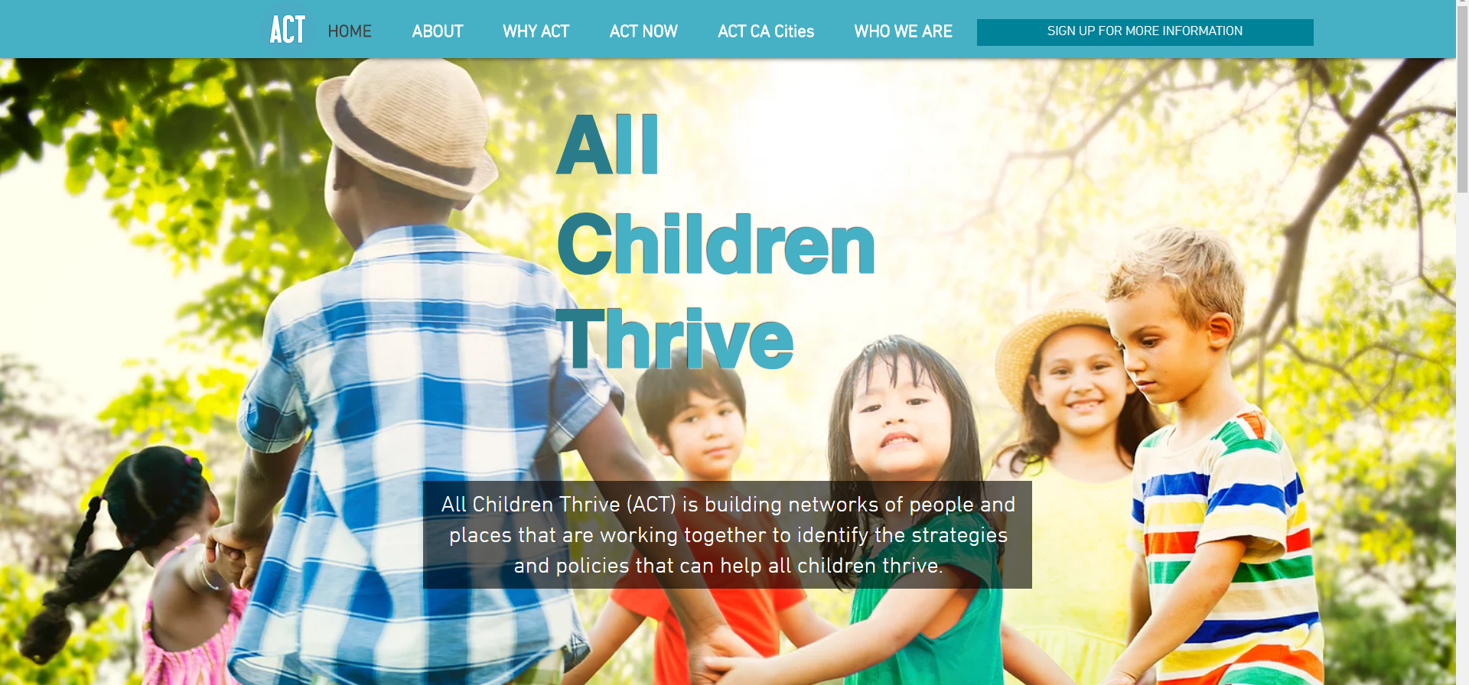

Slide 58
ACT - California
Response to troubling trends in CA
  30% of adolescents report feelings of depression
  Rate of mental health related hospitalizations for youth increasing 50% since 2007
  Rate of self-reported mental health needs among adolescents increasing by 61% since 2005
Many of these are related to Adverse Childhood Experiences (ACEs)
All Children Thrive (ACT) movement offers a statewide strategic agenda to measurably and sustainably reduce the lifelong corrosive effects of childhood poverty and inequality

Slide 59
The Strategy
$10 M allocation from CA Legislature (CDPH, Community Partners, PHAdvocates, UCLA Center for Healthier Children, Families, & Communities
Designed by a team of national and international experts, incubated over 5 years in a number of cities across the country
Three-year, equity-focused, community-driven initiative, takes a city approach, supporting families through evidence-based programs and services that build community resilience, reduced adversity and trauma, and advance the conditions that allow all children to thrive
  … stay tuned!

Slide 60


